Slide 1

Inflation Analysis
Don Irwin & Matt Maroofi
Berkeley MIDS
W200 Project 2 Report
8/3/21
W200 Project 2 Report Matt Maroofi, Don Irwin

Slide 2
Overall Objective and Questions
Our objective is to analyze current market conditions to determine if the official report measures of inflation (CPI and PCE) are accurate. A secondary objective is to attempt to illustrate, inflation and its components utilizing data and data visualization.
Research Questions:
Are the measures of inflation reported by the Fed accurate measures of real inflation in the economy?
What is the historic relationship between interest rates and inflation?
What is the relationship between the money supply M2 and inflation?
Is inflation likely to be transitory or permanent?
What is the impact of inflation on the working class and barely middle class in the United States?
W200 Project 2 Report Matt Maroofi, Don Irwin

Slide 3
Approach
We identified our overall objective and guiding questions for the analysis.
We researched and identified data sets and data sources that would inform our analysis.
We created a prototype, data extraction, cleaning and plotting framework based on, data source APIs, and libraries covered within w200 course material.
We drafted our research paper and its corresponding sections which served as a narrative and guiding document for our data analysis.
We further developed our data extraction and plotting framework, and generated required plots with the relevant data series.
Incorporated all the data, plots and relevant narrative into a holistic research report.
W200 Project 2 Report Matt Maroofi, Don Irwin

Slide 4
Assumptions
We assumed our data sets were accurate given the official government data source.
We assumed the data trends were weighted appropriately across all US regions.
Some of the data series have gaps in their recordings, however the trends are apparent for the years that are relevant for inflationary pressure.
W200 Project 2 Report Matt Maroofi, Don Irwin

Slide 5
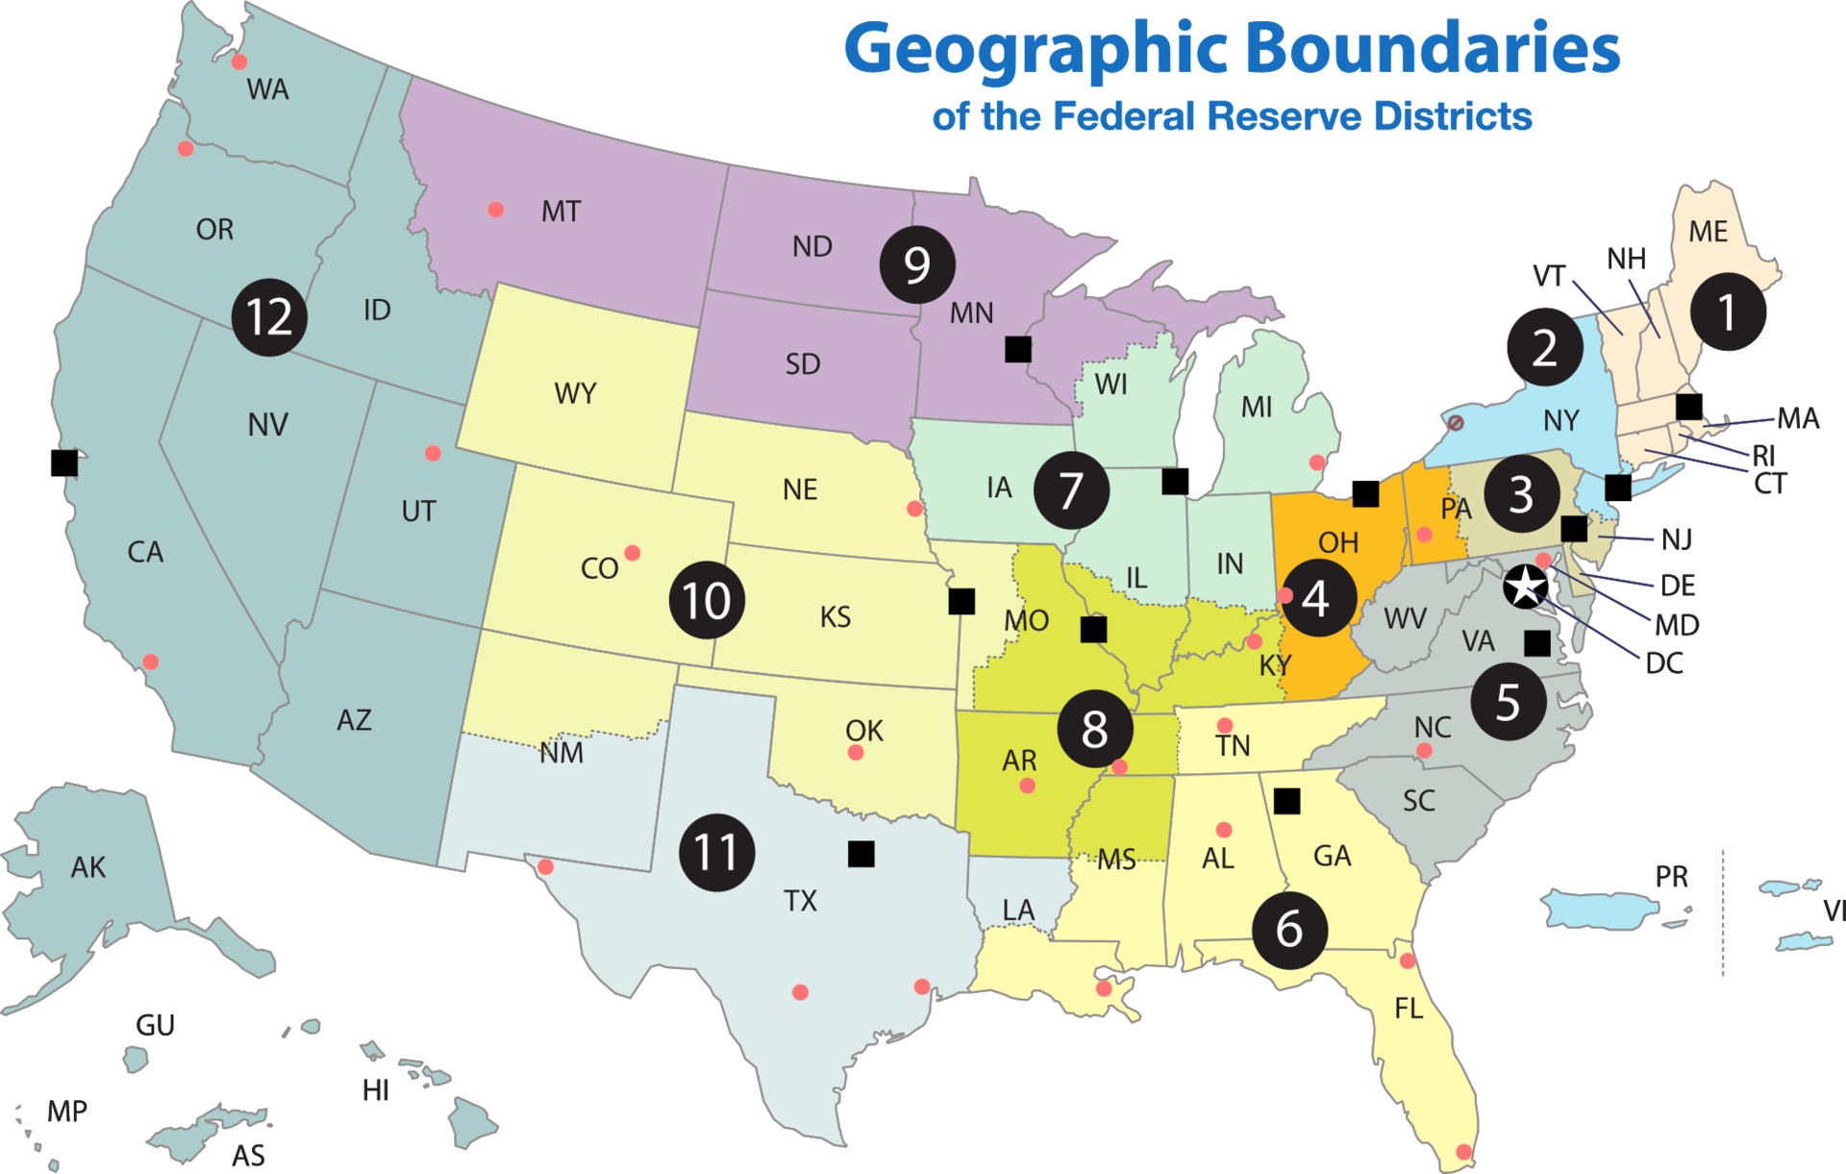
Background
Inflation is an increase in prices and fall in the purchasing value of money. The resulting effect is a decline in the consumer's purchasing power.
Federal Reserve is responsible for the monetary and economic policy of the US Government. There are 12 regional banks.
The Fed is chartered to maximize employment, stabilize prices and moderate long-term interest rates.
The Fed uses open market operations, interest rate adjustments and bank deposit reserve requirements to accomplish its objectives.
Official metrics for measuring inflation are:
Consumer Price Index (CPI)
Personal Consumption Expenditure (PCE)
In addition to price and expenditure inflation there exists asset price inflation. This can be measured by indexes such as:
Case-Schiller home price index.
Dow Jones Industrial Average Index.
Fed Balance sheet as a percentage of GDP.
W200 Project 2 Report Matt Maroofi, Don Irwin

Slide 6
Data Sources and Data Types
Data Types:
Commodity Prices, Precious Metals
Factory Capacity Utilization
Income Indices
Inflation Statistics, Interest Rates
Unemployment Rate
Currency Strength
Fed Balance Sheet.
Worker Share of GDP.
Money Supply.
Data Sources:
https://fred.stlouisfed.org/docs/api/fred/
https://www.bls.gov/data/tools.htm
W200 Project 2 Report Matt Maroofi, Don Irwin

Slide 7
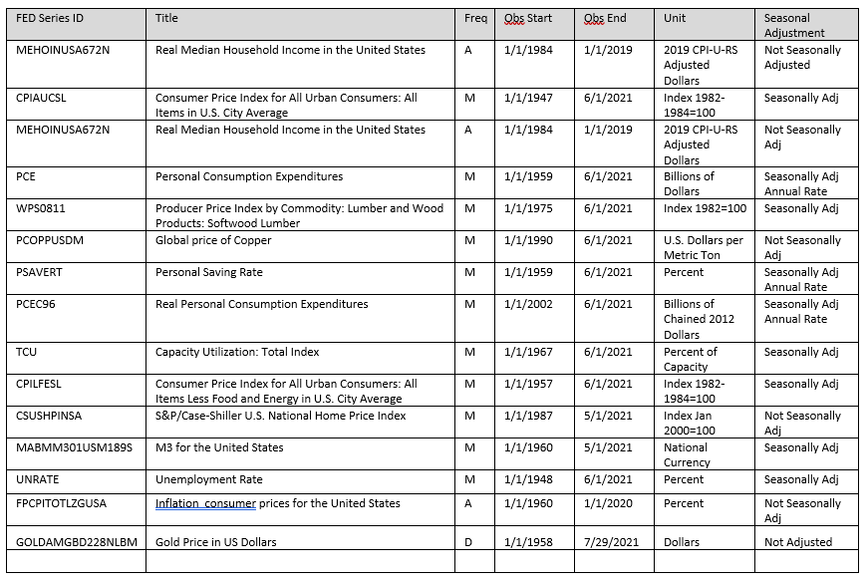
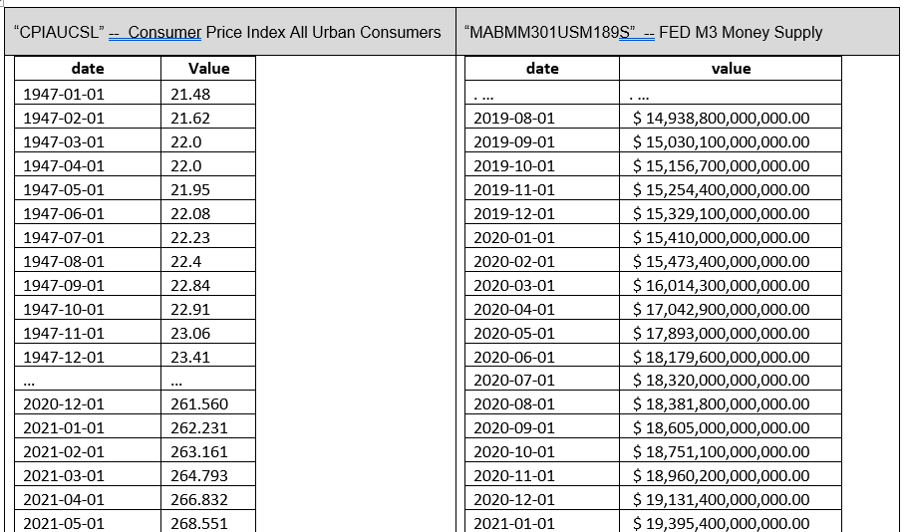
Understanding FED “Series” Data
W200 Project 2 Report Matt Maroofi, Don Irwin

Slide 8
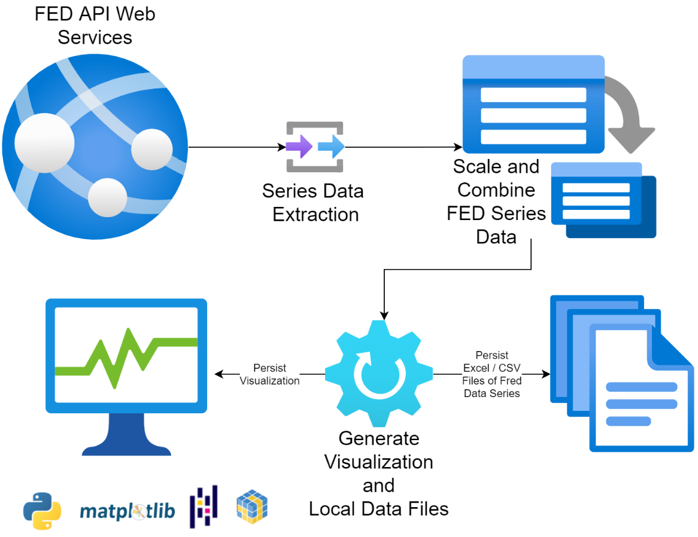
Data Pipeline
W200 Project 2 Report Matt Maroofi, Don Irwin

Slide 9
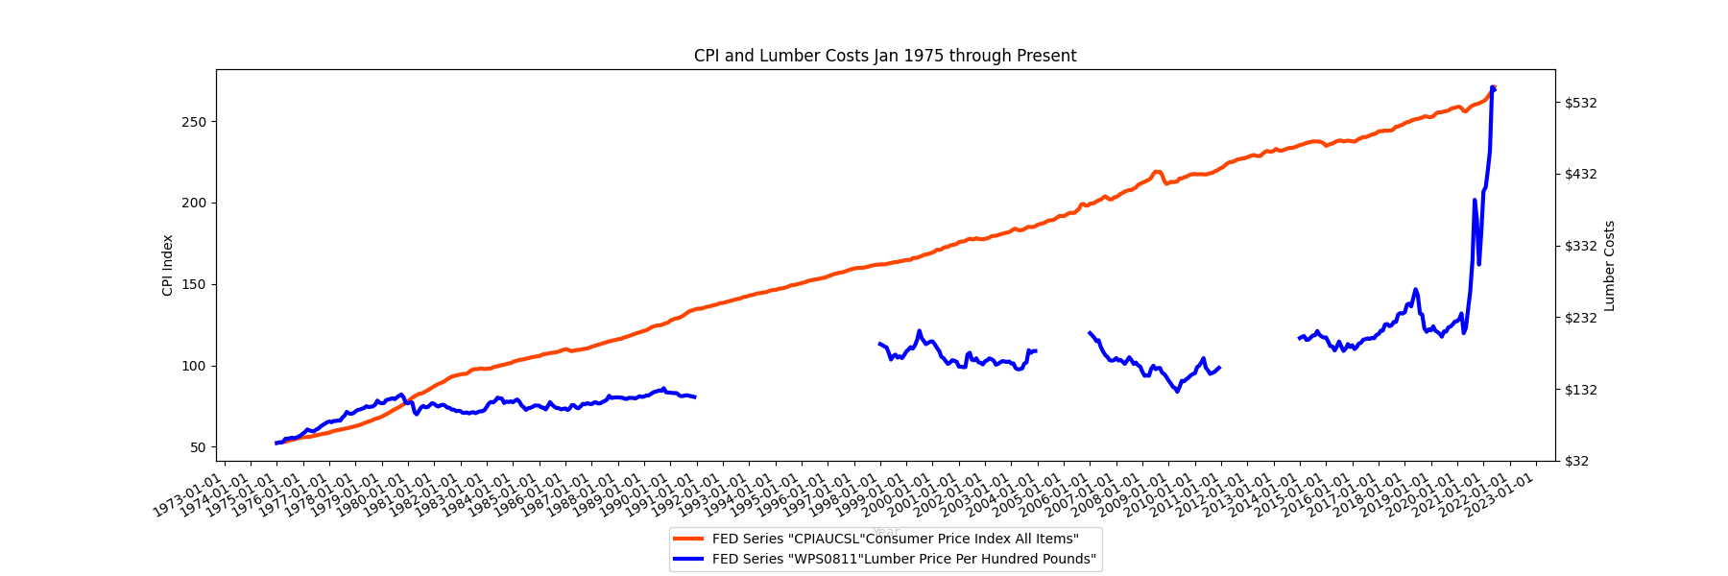
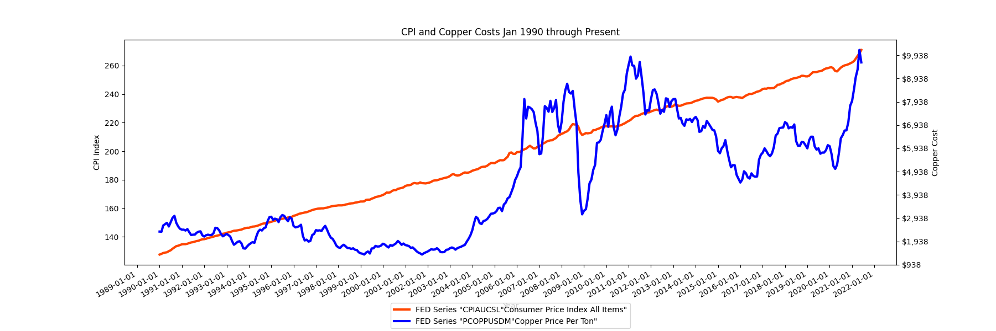
CPI & Supply Costs
W200 Project 2 Report Matt Maroofi, Don Irwin

Slide 10
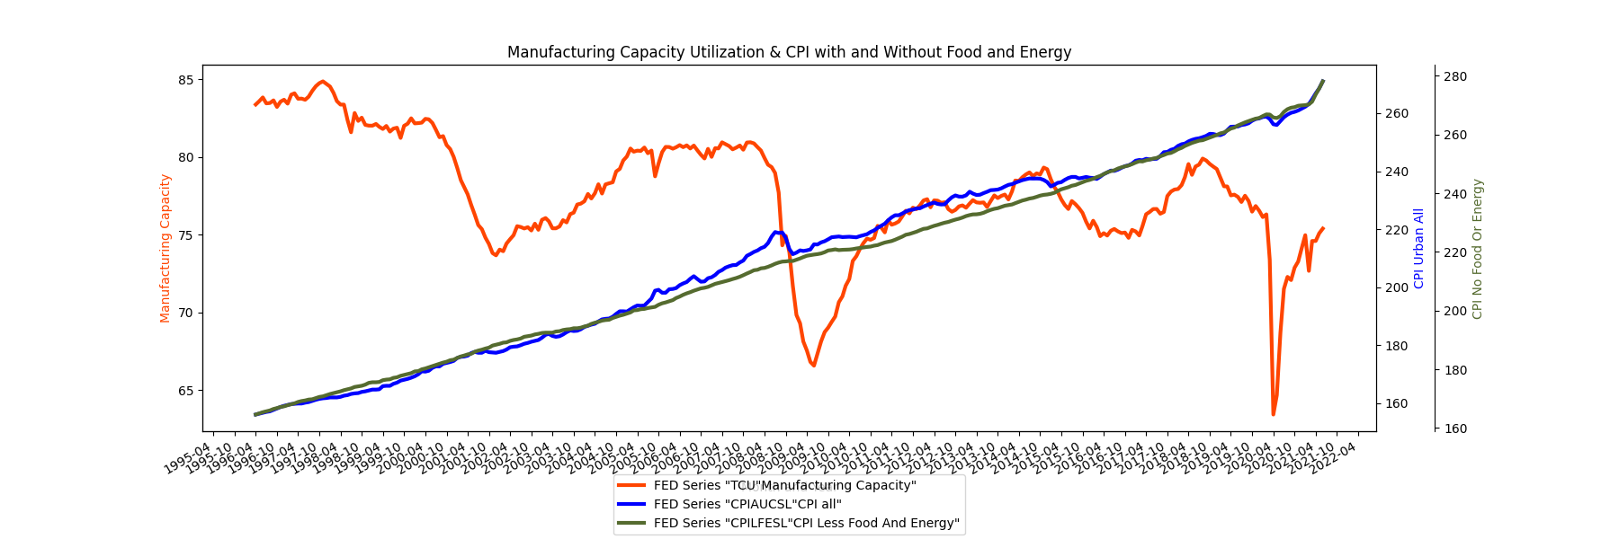
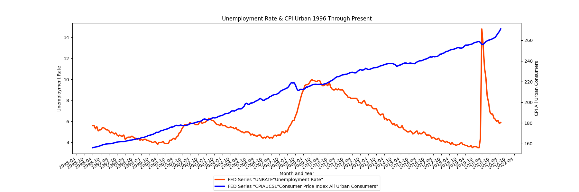
CPI with Unemployment Rate & Manufacturing
W200 Project 2 Report Matt Maroofi, Don Irwin

Slide 11
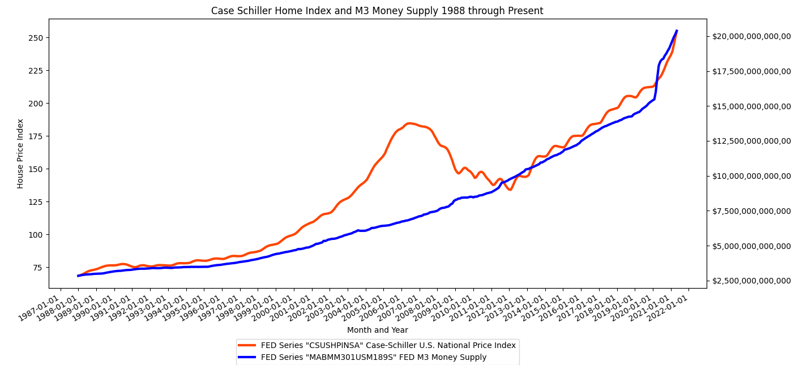
Asset Inflation Part 1:
W200 Project 2 Report Matt Maroofi, Don Irwin

Slide 12
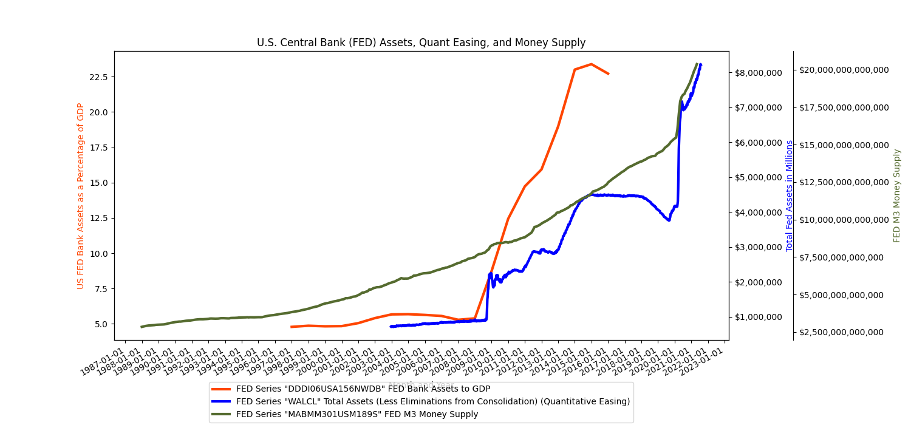
Asset Inflation Part 2: GDP disconnected from “normal” economic measures.
W200 Project 2 Report Matt Maroofi, Don Irwin

Slide 13
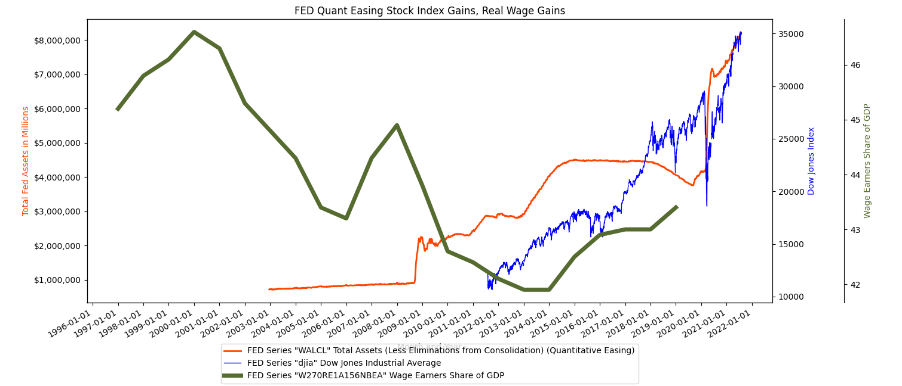
Asset Inflation Part 3: Assets Versus Workers share of GDP
W200 Project 2 Report Matt Maroofi, Don Irwin

Slide 14
Conclusion
The official indicators of inflation such as the indexes (CPI and PCE) while inclusive of thousands of variables are not ideal in measuring rapid variations of inflationary pressure. Secondary discrete real-time measures can be used to assess the upward inflationary measures as indicated in our analysis.
Asset inflation is at an all time high and because of the financialization of the entire economy, asset inflation is being transmitted into cost and price inflation. I.E. If I pay a million dollars for an apartment building, I am going to demand more in rents than if I paid half that.
Workers wages as a percentage of GDP has not kept up with asset inflation, creating a situation where that transmission of asset inflation to consumer price inflation is unstable.
If the FED were to raise interest rates, they could likely control inflation. However, they are unlikely to raise rates because the economy is in a “debt trap”, whereby doing so would cause asset prices to crash.
Follow on research should include a broader selection of secondary data discrete measures and inclusion of geographic regional zones vs a nation wide approach.
W200 Project 2 Report Matt Maroofi, Don Irwin

Slide 15
Scope of Presentation
Your overall question
The steps your group took to analyze the question
Any assumptions you made in the analysis
The key is to aim for clarity and telling a story with the data
Organize your argument clearly
Guide the listeners through the evidence in the data
Include any key figures/plots/charts or graphs
You do not need to show any code but it might be handy to have the code ready in case there are some questions on it
W200 Project 2 Report Matt Maroofi, Don Irwin

